Slide 1
What’s new in C# Dev Kit?
Leslie Richardson & Wendy Breiding

Slide 2
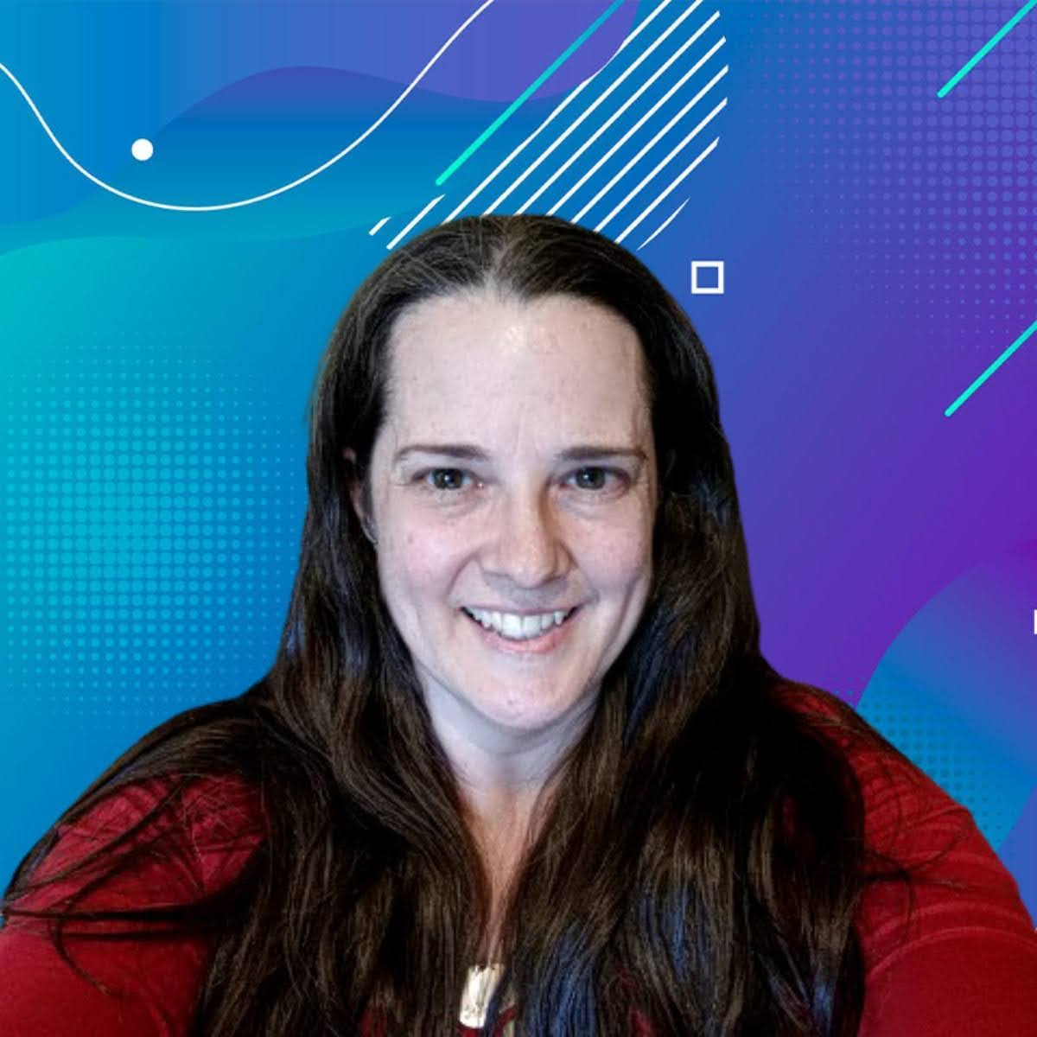
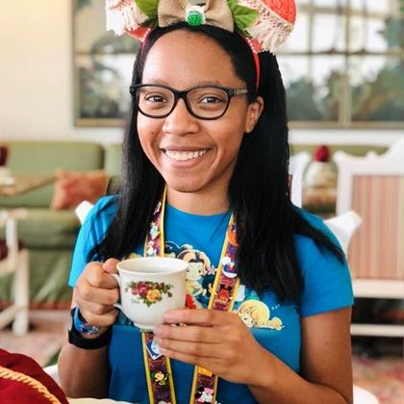
Wendy Breiding
Leslie Richardson
Senior Manager, Product Management
Senior Product Manager

Slide 3
Agenda
01
02
03
What is C# Dev Kit?
Demos
Feedback

Slide 4
01
What is C# Dev Kit?

Slide 5
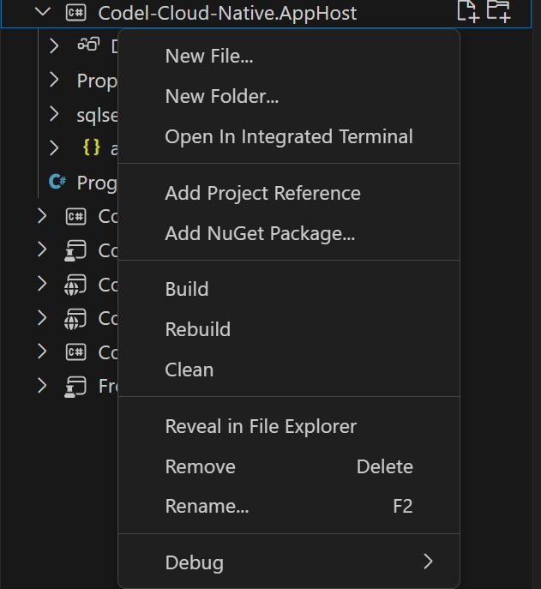
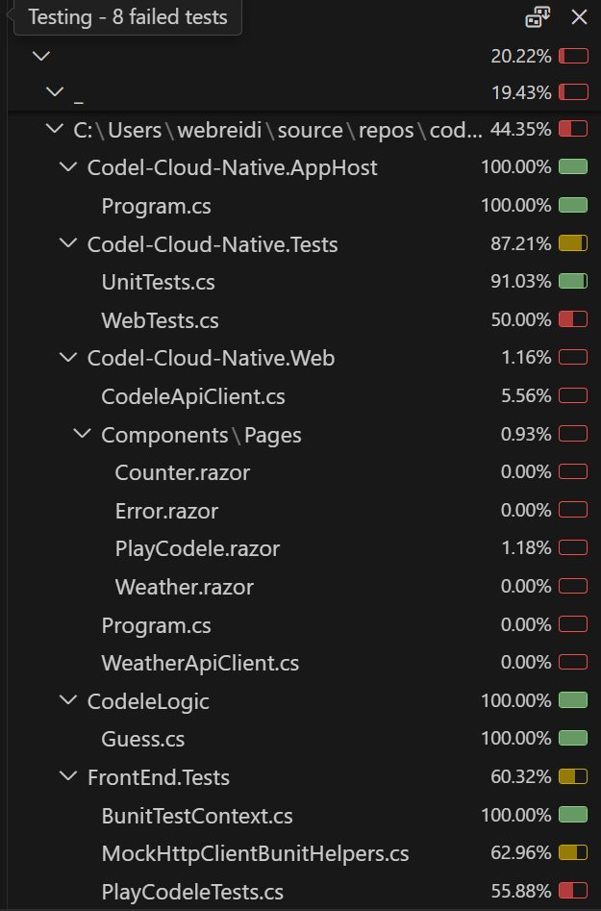
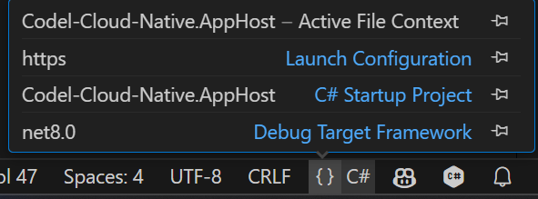
C# Dev Kit
Solution & Project Management
Developer Productivity
Testing
Solution Explorer
Manage files, folders, projects
Manage NuGet Packages
Roslyn-powered IntelliSense, code navigation, and refactoring
1-click run/debug, no set-up required
.NET Aspire support
Test Explorer integration
Run tests with Code Coverage
Inline failure analysis

Slide 6
Demo
Notes:
- Install/Uninstall SDK
- create new .NET Aspire project with options
- set up of launch configuration
- run
- dotnet scaffold
- install (dotnet tool install --global Microsoft.dotnet-scaffold --version 9.0.0-rc.1.24511.1)
- Aspire
- database
- npgsql
-view changes
- update NuGet packages
- run
- new file
- new folder
- drag/drop files
- generate tests of weather method with copilot (change record to public)
- add project reference to API
switch to Codele
run tests with code coverage
Show inline failures
- Debug across projects
- set breakpoint in razor file and .cs file
- fix 3 issues
- no warning message when > or < 5 attempts
- lets user make 6 attempts
- duplicate flagging
- Provide Feedback

Slide 7
Resources
Download C# Dev Kit
Send Feedback
Documentation
https://marketplace.visualstudio.com/items?itemName=ms-dotnettools.csdevkit
https://github.com/microsoft/vscode-dotnettools/issues
https://code.visualstudio.com/docs/csharp/get-started
.NET Aspire Documentation
.NET Aspire Codele Example
C# Extension Feedback
https://learn.microsoft.com/en-us/dotnet/aspire/get-started/aspire-overview
https://github.com/webreidi/codel-cloud-native
https://github.com/dotnet/vscode-csharp/issues

Slide 8
Other Sessions
Building and deploying an Azure Functions app with .NET Aspire in 25 minutes
What's new in C# 13
What's New in .NET MAUI in .NET 9
Safia Abdalla
Wednesday, November 13
10:00 AM - 10:30 AM PST
Mads Torgersen, Dustin Campbell
Tuesday, November 12
10:30 AM - 11:15 AM PST
David Ortinau, Rachel Kang (SHE/HER)
Tuesday, November 12
12:00 PM - 12:45 PM PST

Slide 9
Thank you

